Slide 1
Deep Learning Training
Lecture 3: Generalization, Regularization and hyperparameter tuning

Slide 2
Topic Names
Overfitting-Underfitting
Regularization
Dropout
Hyperparameter Tuning

Slide 3
Generalization
In machine learning our target is to have a general sense about data. So that in case of unseen situation model can make reasonably good decision.
We want our model to be able to handle unseen situation well.
How machine learning differs from simple curve fitting or interpolation

Slide 4
Overfitting
Model’s representational capacity much larger than the function we are trying to model
If our model explains the data too well. Then possibly it’s overfitted.
Overfitting can be compared with memorizing or misunderstanding due to less knowledge. When we memorize we don’t understand the reason but we can tell about our knowledge very well.
Associated with low training error and large validation/test error

Slide 5
Underfitting
Underfitting is opposite of overfitting.
In case of underfitting model can explain the available information well enough.
This can be compared with not completing the whole syllabus before exam.
An underfitted model is not capable of making complex decision.
Associated with large training error

Slide 6
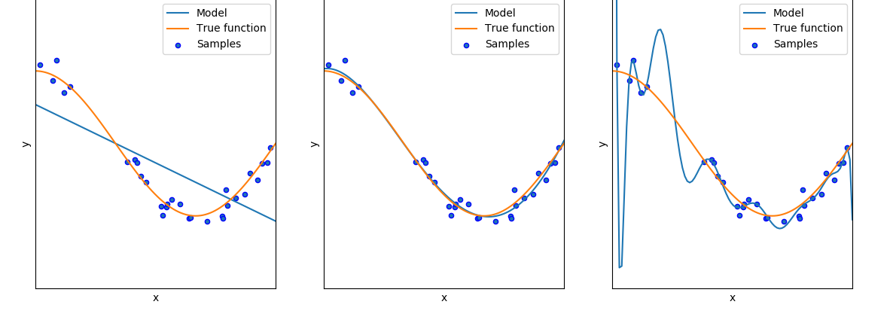
Overfitting-Underfitting
Figure: left - underfitting, middle – good generalization, right – overfitting source

Slide 7
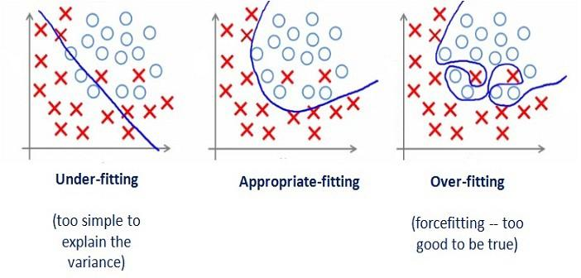
Overfitting-Underfitting
Figure: Overfitting/Underfitting source
*** So, we see that neither high bias nor high variance is good, usually.

Slide 8
How to determine if overfitting or underfitting
We said possibly overfitted/underfitted. How to be sure?
Basic idea is overfitting model capture known data pattern too exactly and thus performs bad in unseen data.
Underfitting can not explain seen data well let alone unseen data
We will split our data into 3 parts
Train Data
Validation Data
Test Data

Slide 9
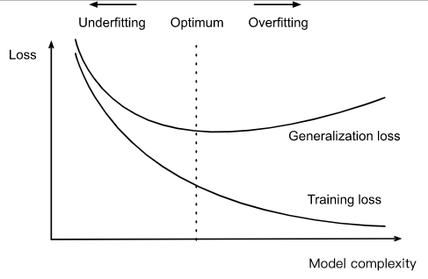
How to determine if overfitting or underfitting

Slide 10
Causes of Overfit and Underfit
Causes of overfitting
Small amount of data but model is capable of making complex decision (complex model)
Training for too long
Causes of underfitting
Amount of data is small
Simple model
Not enough training is done

Slide 11
Regularization
“Regularization is any modification we make to a learning algorithm that is intended to reduce its generalization error but not its training error.” reference[1]
Main objective of regularization is avoiding model overfitting
Deep neural network has many parameters to learn. Due to this many parameters it can learn complex pattern.
For similar reason it is prone to overfitting
We will see this regularization technique
L1, L2 regularization
early stopping

Slide 12
L1,L2 Regularization
L1 and L2 regularization works by reducing the model complexity
In machine learning we model the learning problem as an optimization problem of an error function
We change the error function such a way that the optimization target is learning error + model weight(parameter value) [regularization term]
Model complexity is reduced by reducing the regularization term

Slide 13
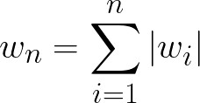
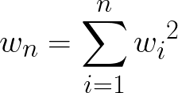
L1,L2 Norm
Two types of norm of the weights are used as regularization term
L1 regularization/Lasso regularization use L1 norm as regularization term
L2 regularization/Ridge regularization use L2 norm as regularization term
L1 norm of model weights, w
L2 norm of model weights, w

Slide 14
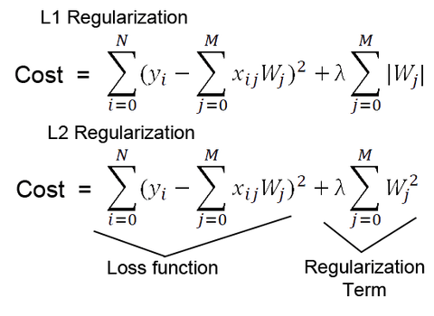
L1, L2 Regularization

Slide 15
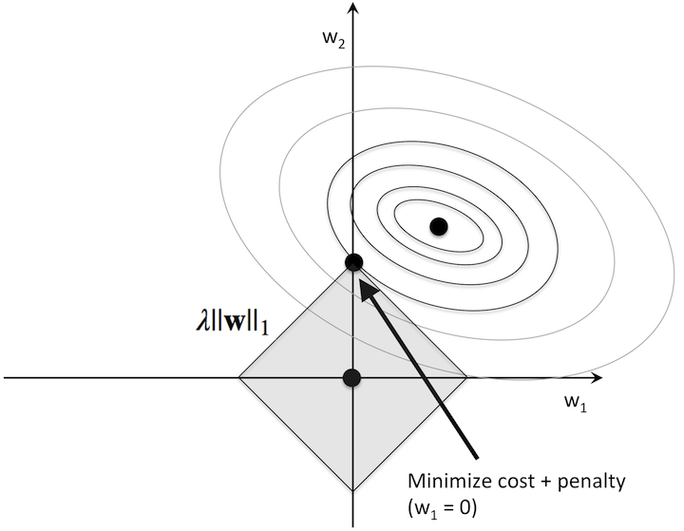
Effects of L1,L2 Regularization
L1 regularization may remove weights from model by zeroing them
L1 regularization creates sparser model
For weight removal capacity it can act as a feature selector
image source[5]
Figure: L1 regularization source

Slide 16
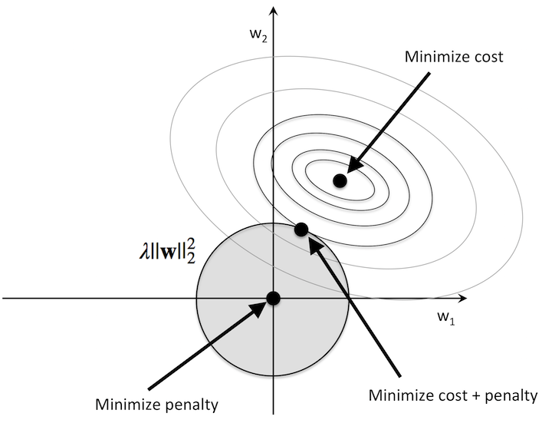
Effects of L1,L2 Regularization
L2 regularization does not always remove weights while regularizing
Figure: L2 regularization source

Slide 17
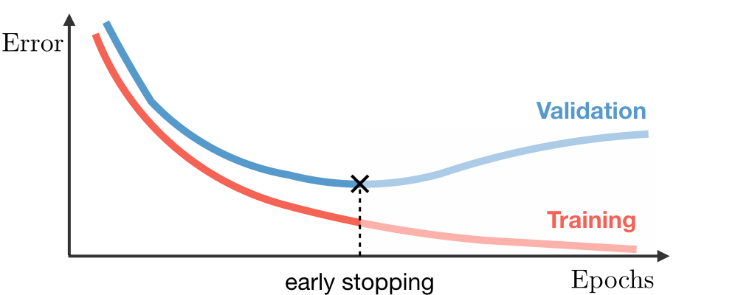
Early Stopping
Early stopping is stop the training earlier than defined duration (epoch) Training too long will lead to overfitting but we don’t know how long
So, training error and validation error is observed. After an epoch if training error is reducing but validation error starts to improve, it indicates overfitting has started. So, we have to stop training.
Figure: Early stopping source

Slide 18
Dropout
When training neural network, we first make forward propagation then according to it’s output we apply backward propagation on network.
In dropout, while making this forward propagation we dropped the output of neuron with some probability.
This is done only in training stage. No dropout is applied in forward propagation while inferring.

Slide 19
Dropout
Figure Dropout source

Slide 20
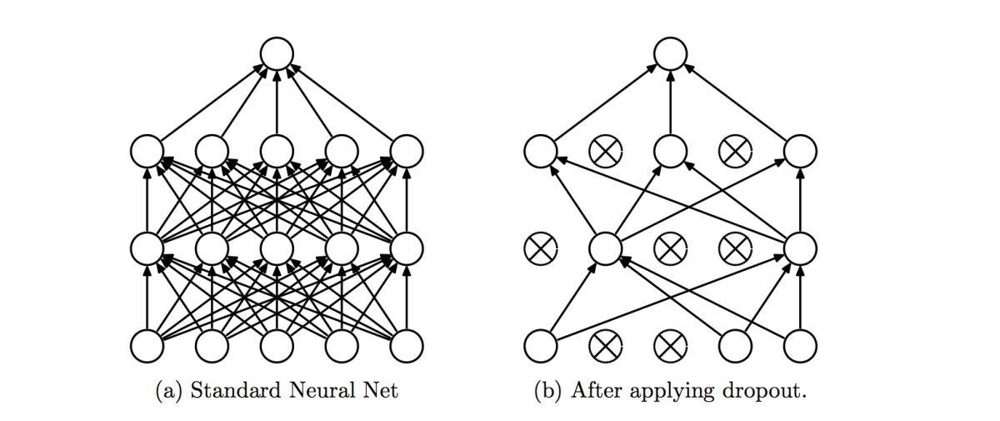
Dropout Effect
Regularization
Less gradient update per iteration
Increases number of epochs
Figure: Network pruned after dropout source

Slide 21
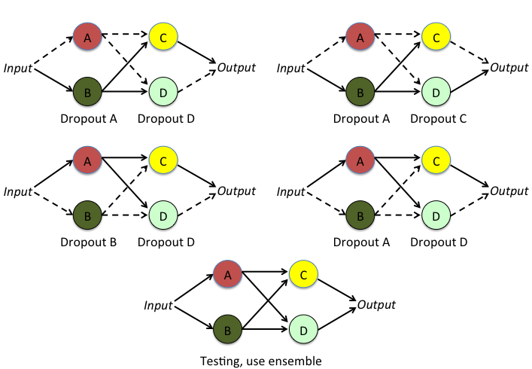
Dropout Effect
Emulate ensembled learning
Figure: ensemble effect of dropout source

Slide 22
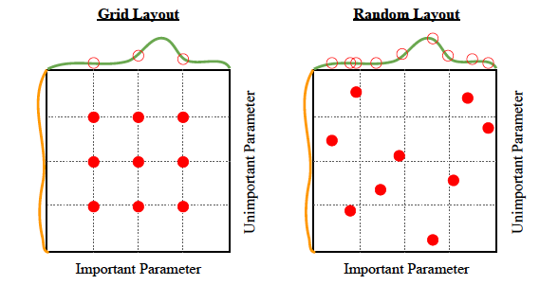
Hyperparameter Searching
Hyperparameter searching is a difficult problem. Range of each hyperparameter is large and we don’t know where to search
There are two approaches
Grid search
Random search

Slide 23
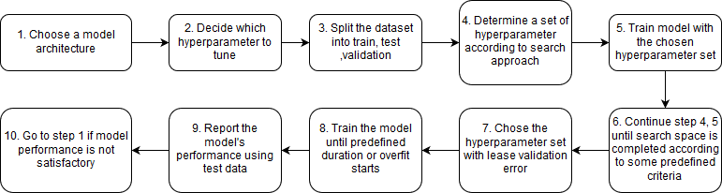
Hyperparameter Tuning Workflow

Slide 24
Tasks
Regularization in PyTorch
Early stopping
L1/L2
Dropout
Draw training history
Use Tensor Board

Slide 25
Thank You

Slide 26
References
https://www.deeplearningbook.org/
http://rasbt.github.io/mlxtend/user_guide/general_concepts/regularization-linear/
https://datascience.stackexchange.com/questions/23728/why-using-l1-regularization-over-l2
https://medium.com/@amarbudhiraja/https-medium-com-amarbudhiraja-learning-less-to-learn-better-dropout-in-deep-machine-learning-74334da4bfc5
https://www.deeplearningbook.org/contents/guidelines.html

